Slide 1
Non-Staff Board Cleaner
A.k.a Automatic Duster
Shivam Namdeo
Pratyun Choubey
Hitisha Gohil
Team :
Branch/Semester : CSE Semester 1
Time Required : 2 Weeks

Slide 2
Aim
For the convenience of the Teachers & Students.
Neither Code nor Mechanism using Arduino is available Online .
For the protection of our beloved teachers who are allergic to chalk powder.
It saves Time and Direct Electricity.
Makes Board Visible in low light condition & Prevents it from reflection.
Thank You ☺.

Slide 3
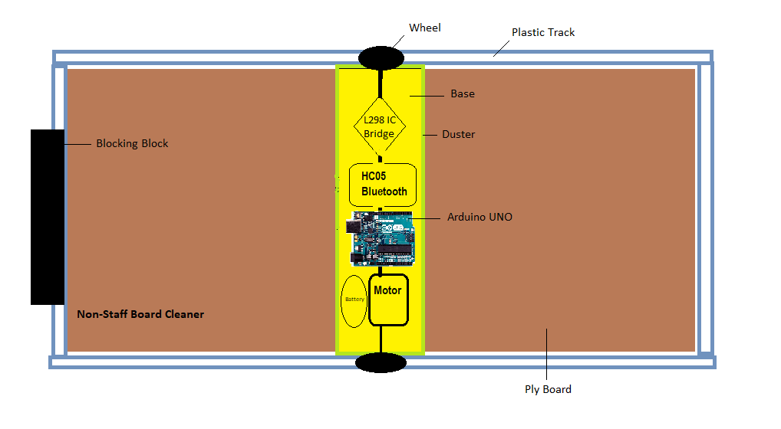
Diagram

Slide 4
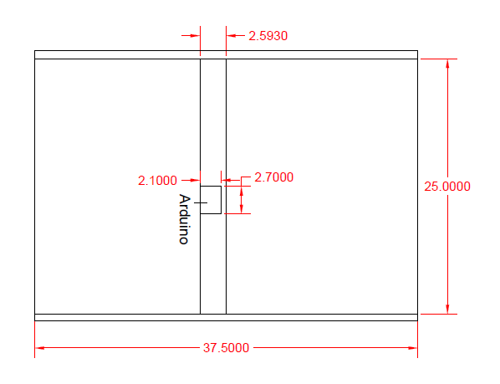
Dimension

Slide 5
ITEM REQUIRED:
S. No. | Product Discription | Qty. | Price per piece | Total Amount(in Rs.) | Source
1 | Ply Board 37.5*24 inch | 1 | 40 | 40
2 | Sq. Plastic pipe 2.5 m | 1 | 50 | 50 | indiamart.com
3 | Arduino UNO R3 | 1 | 350 | 350 | electronicscomp.com
4 | Dual Side Motor | 1 | 50 | 50 | electronicscomp.com
5 | Jumper Wire | 40 | 65 | 65 | rubo.in
6 | L298 IC Bridge | 1 | 95 | 95 | electronicscomp.com
7 | 9 V Battery | 1 | 110 | 110 | rubo.in
8 | HC05 Bluetooth Module | 1 | 200 | 200 | electronicscomp.com
9 | LED Strip | 37.5 inch * 2 | 250 | 500
9 | Wheels | 2
TOTAL |  |  |  | Appr.1500

